Slide 1
NETFLIX MOVIES AND TV SHOWS CLUSTERING
Sai Naga Samhita
Shubham More
Shiva Krishna Reddy
Sudharsun
Pavithra
Sapana

Slide 2
CONTENT
Introduction
Problem Statement
Data description
Exploratory Data Analysis (EDA)
Hypothesis Testing
Feature Engineering
Machine Learning model implementation
1. K – Means Clustering
2. Hierarchical Clustering
Content based recommender system
Deployment

Slide 3
INTRODUCTION
Netflix is an American subscription video on-demand over-the-top streaming service.
Launched on January 16, 2007, nearly a decade after Netflix, Inc. began its pioneering DVD‑ by‑ mail movie rental service, Netflix is the most-subscribed video on demand streaming media service, with 260.28 million paid memberships in more than 190 countries as of January 2024.
The service primarily distributes original and acquired films and television shows from various genres, and it is available internationally in multiple languages.
This business is profitable because users make a monthly payment to access the platform. However, customers can cancel their subscriptions at any time.

Slide 4
PROBLEM STATEMENT
The dataset consists of various Netflix series and movies available and their different features.
Task 1
Try to find some more features through data mining techniques and feature engineering to get better quality analysis.
Task 2
Using the clustering techniques, prepare clusters from the data and by finding the unique features from those clusters, provide suggestions to Netflix on how they can give better recommendations and improve their business and app.

Slide 5
DATA DESCRIPTION
The dataset consists of listings of all the movies and TV shows available on Netflix, along with details such as - cast, directors, ratings, release year, duration, etc.
The dataset consists of eleven object data type columns and one integer data type column.
1) show_id : Unique ID for every movie / tv show
2) type : Identifier - A movie or tv show
3) title : Title of the Movie / tv show
4) director : Director of the movie
5) cast : Actors involved in the movie / show
6) country : Country where the movie / show was produced
7) date_added : Date it was added on Netflix
8) release_year : Actual release year of the movie / show
9) rating : TV rating of the movie / show
10) duration : Total duration - in minutes or number of seasons
11) listed_in : Genres
12) description: The summary description

Slide 6
DATA VISUALIZATION
There are 3 types of analysis:
Univariate Analysis : Univariate analysis explores each variable in a data set, separately.
Bivariate Analysis : Bivariate analysis is stated to be an analysis of any concurrent relation between two variables or attributes.
Multivariate Analysis : Multivariate analysis involves evaluating multiple variables (more than two) to identify any possible association among them.

Slide 7
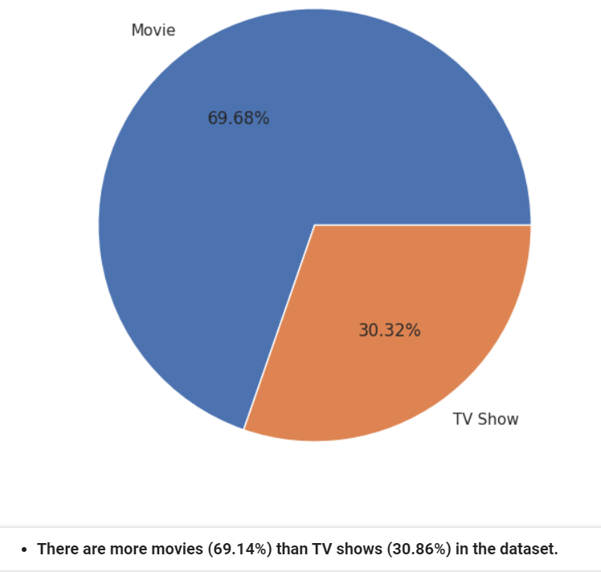
UNIVARIATE ANALYSIS
Type (Movies and TV shows)

Slide 8
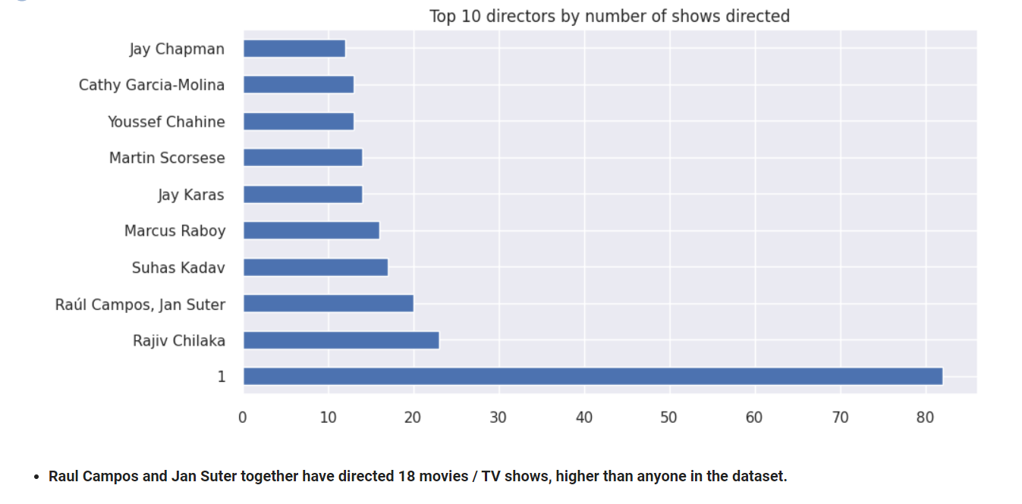
Top 10 directors

Slide 9
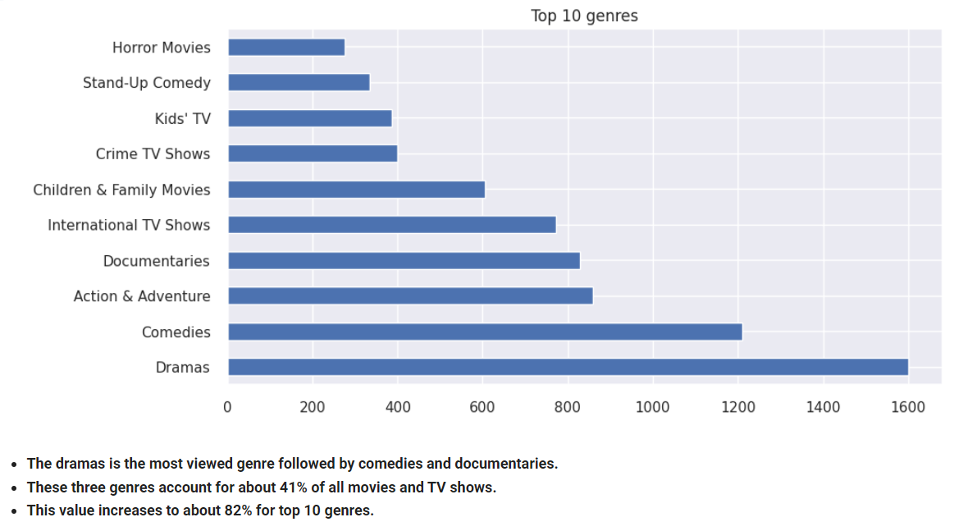
Top 10 genres (listed_in)

Slide 10
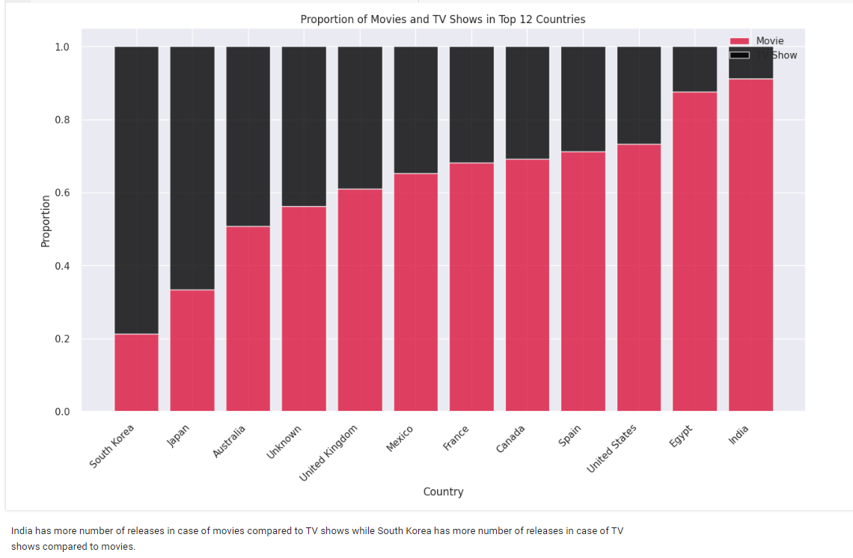
BIVARIATE ANALYSIS
Proportion of movies and TV shows

Slide 11
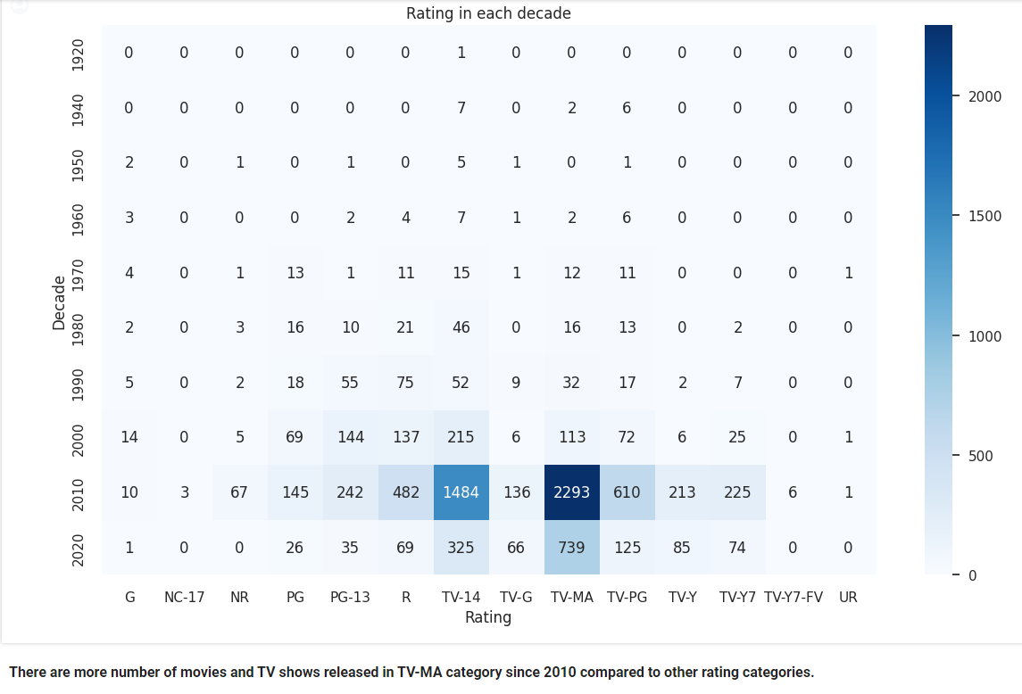
Rating in each decade

Slide 12
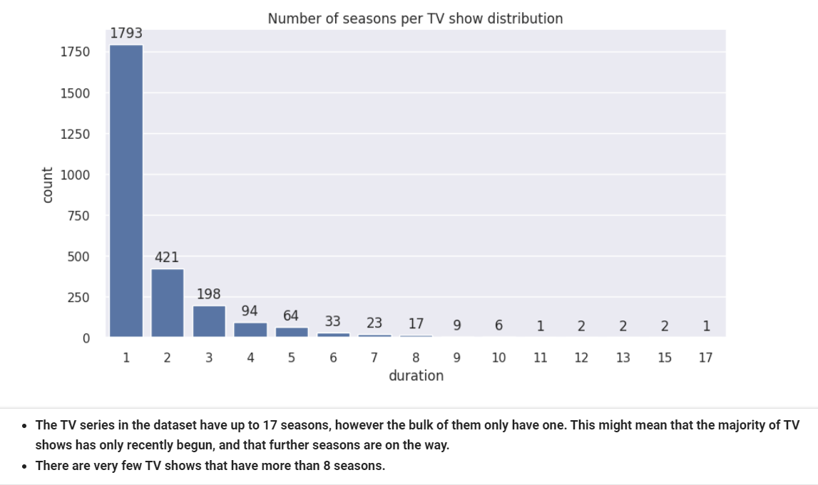
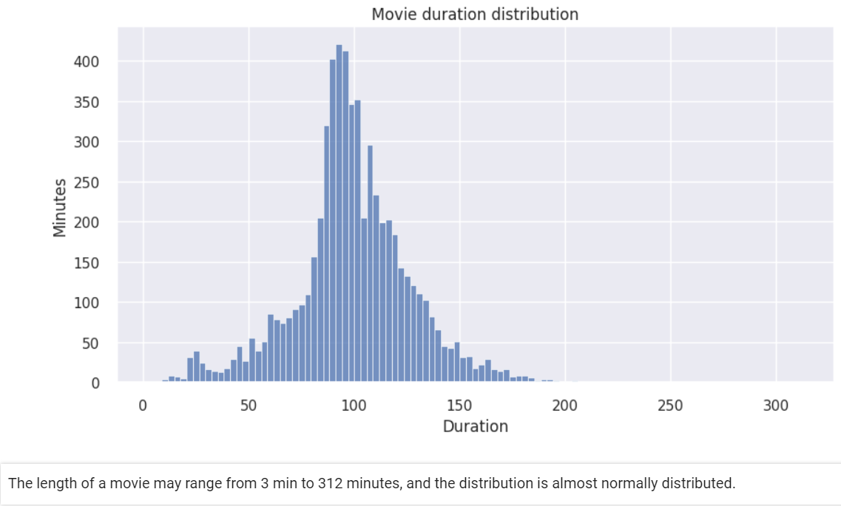
Duration of TV shows
Duration of movies

Slide 13
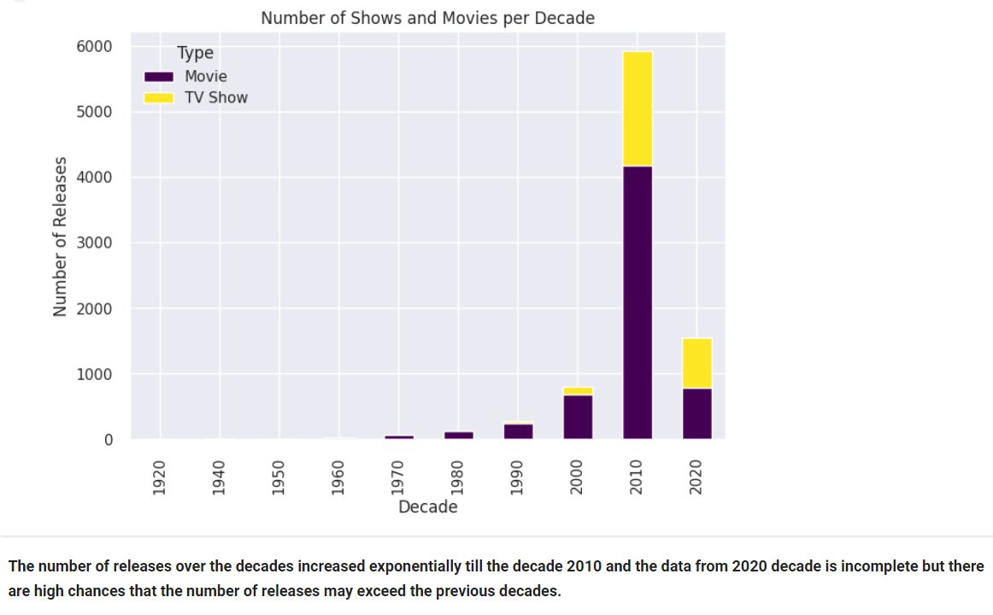
Number of TV shows and movies per decade

Slide 14
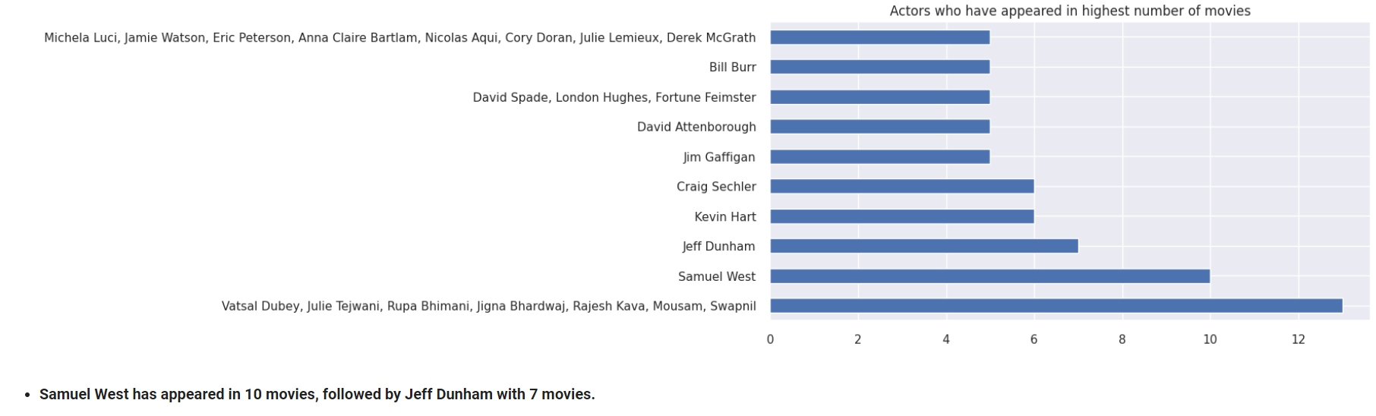
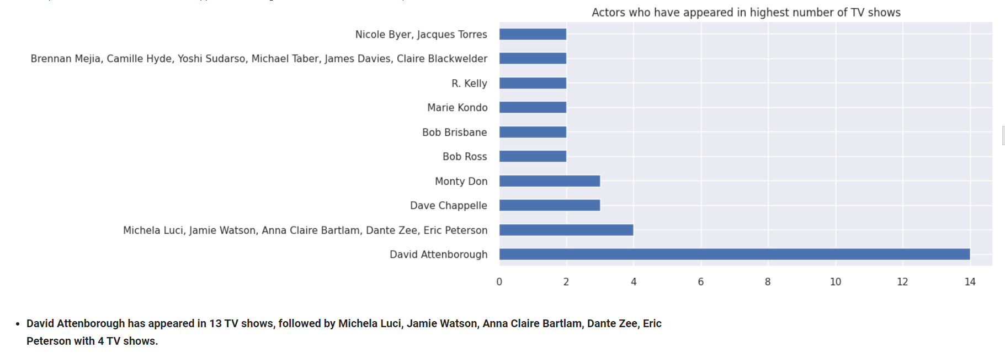
Actors who appeared in highest number of movies
Actors who appeared in highest number of TV shows

Slide 15
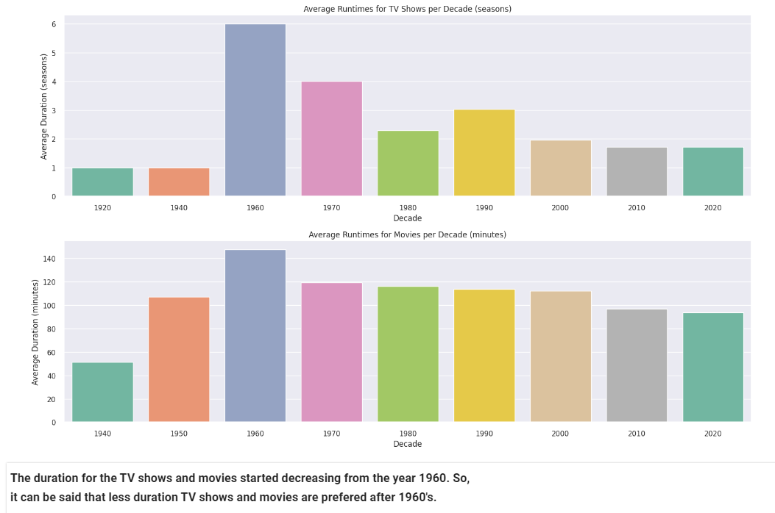
MULTIVARIATE ANALYSIS
Average runtime for TV shows and movies per decade

Slide 16
HYPOTHESIS TESTING
Hypothesis Testing is a type of statistical analysis in which you put your assumptions about a population parameter to the test.
It is used to estimate the relationship between two statistical variables.
Analysts use a random population sample to test two hypotheses: the null and alternative hypotheses.

Slide 17
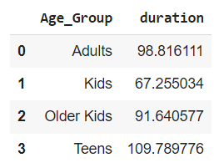
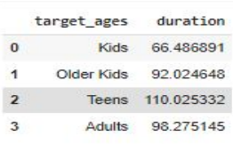
TEST - 1
H0 : Movies rated for kids and older kids are at least two hours long
H1 : Movies rated for kids and older kids are not at least two hours long.
The t-value is not in the range, the null hypothesis is rejected.
As a result, movies rated for kids and older kids are not at least two hours
TEST - 2
H1 : The duration which is more than 90 minutes are movies
H0 : The duration which is more than 90 minutes are not movies
The t-value is not in the range, the null hypothesis is rejected.
As a result, The duration which is more than 90 minutes are movies

Slide 18
FEATURE ENGINEERING
Select the attributes based on which you want to cluster the shows
Text preprocessing: Remove all non-ascii characters, stop words and punctuation marks, convert all textual data to lowercase.
Lemmatization to generate a meaningful word out of corpus of words
Tokenization of corpus
Word vectorization
Dimensionality reduction

Slide 19
ML IMPLEMENTATION – CLUSTERING
Clustering is the task of dividing the unlabeled data or data points into different clusters such that similar data points fall in the same cluster than those which differ from the others.
In simple words, the aim of the clustering process is to segregate groups with similar traits and assign them into clusters.
In this project we are using K – Means and Hierarchical (Agglomerative) types of clustering.

Slide 20
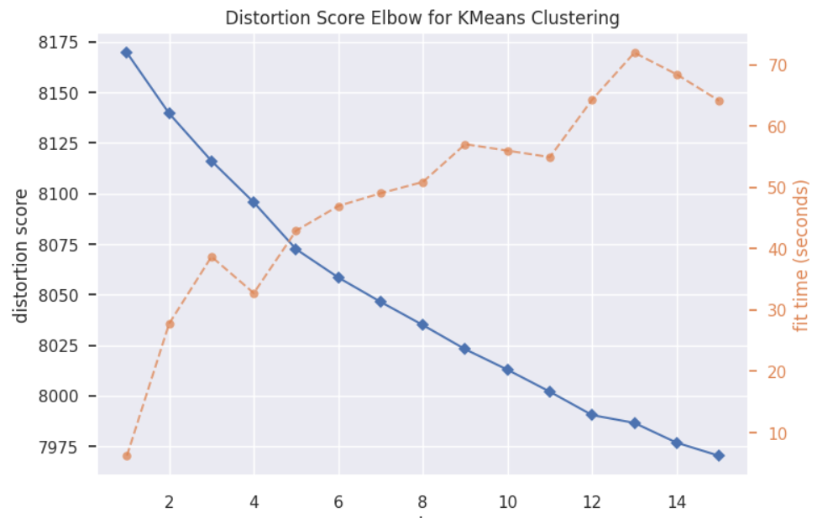
K - MEANS
K-Means clustering is an unsupervised learning algorithm which groups the unlabeled dataset into different clusters.
Here K defines the number of predefined clusters that need to be created in the process, as if K=2, there will be two clusters, and for K=3, there will be three clusters, and so on.
An elbow plot shows at what value of k, the distance between the mean of a cluster and the other data points in the cluster is at its lowest.
Two values are of importance here — distortion and inertia. Distortion is the average of the Euclidean squared distance from the centroid of the respective clusters.

Slide 21
Evaluation
Silhouette score is a metric to evaluate the performance of clustering algorithm.
It uses compactness of individual clusters(intra cluster distance) and separation amongst clusters (inter cluster distance) to measure an overall representative score of how well our clustering algorithm has performed.
Silhouette score would always lie between -1 to 1 and 1 represents better clustering.
For k=2, Silhouette score = 0.002775
For k=3, Silhouette score = 0.003452
For k=4, Silhouette score = 0.004341
For k=5, Silhouette score = 0.004851
For k=6, Silhouette score = 0.004429

Slide 22
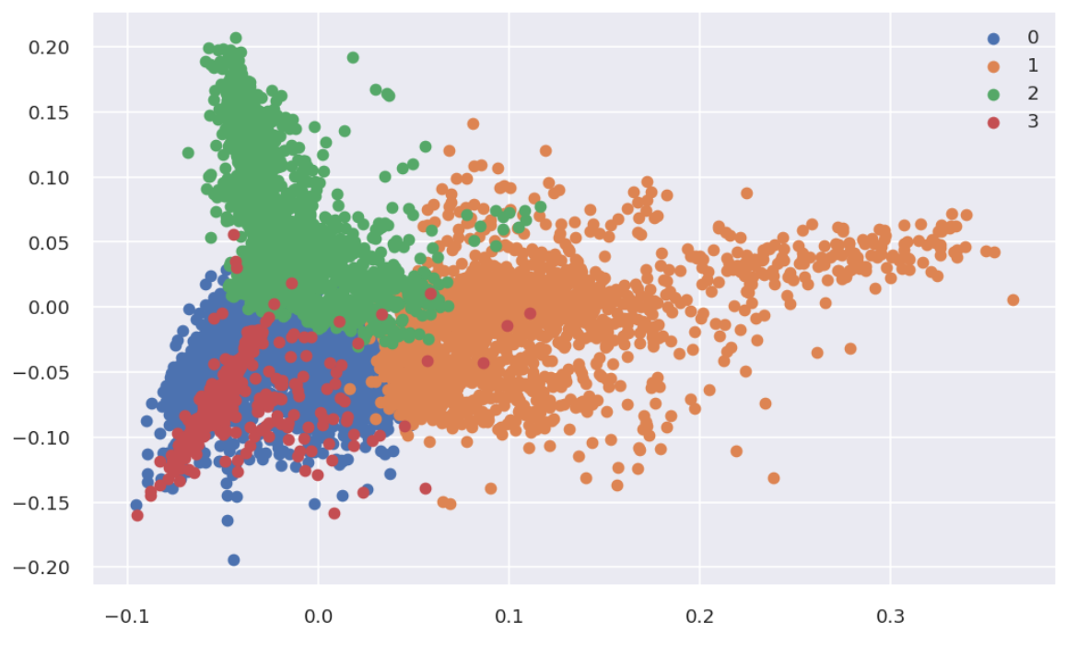
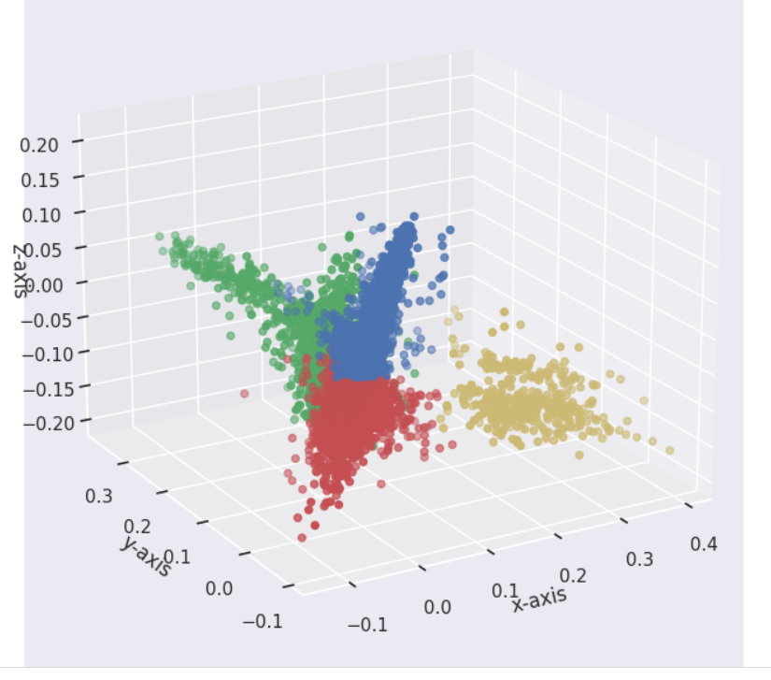
K – MEANS CLUSTERING GRAPHS
Graph in 2 - dimension
Graph in 3 - dimension

Slide 23
HIERARCHICAL (AGGLOMERATIVE) CLUSTERING
Hierarchy - means tree like structure.
Hierarchy structure is also called as Dendrogram structure.
Dendogram helps to identify what observations are similar to each other in the data.
Agglomerative hierarchical clustering is a popular example of hierarchical clustering.
It is called agglomerative because in this you are aggregating (adding) information from bottom to top step by step and create a hierarchical structure.
For k=2, Silhouette score = 0.001545
For k=3, Silhouette score = 0.002264
For k=4, Silhouette score = 0.002205
For k=5, Silhouette score = 0.002737
For k=6, Silhouette score = 0.003298
For k=7, Silhouette score = 0.002958
For k=8, Silhouette score = 0.003379
For k=9, Silhouette score = 0.003836

Slide 24
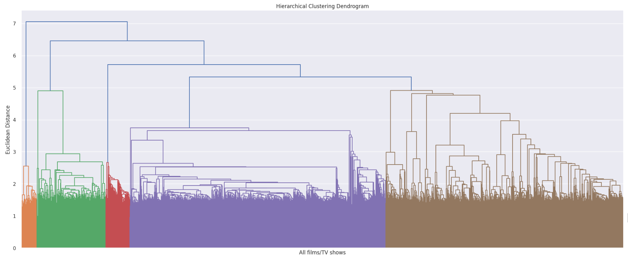
DENDOGRAM

Slide 25
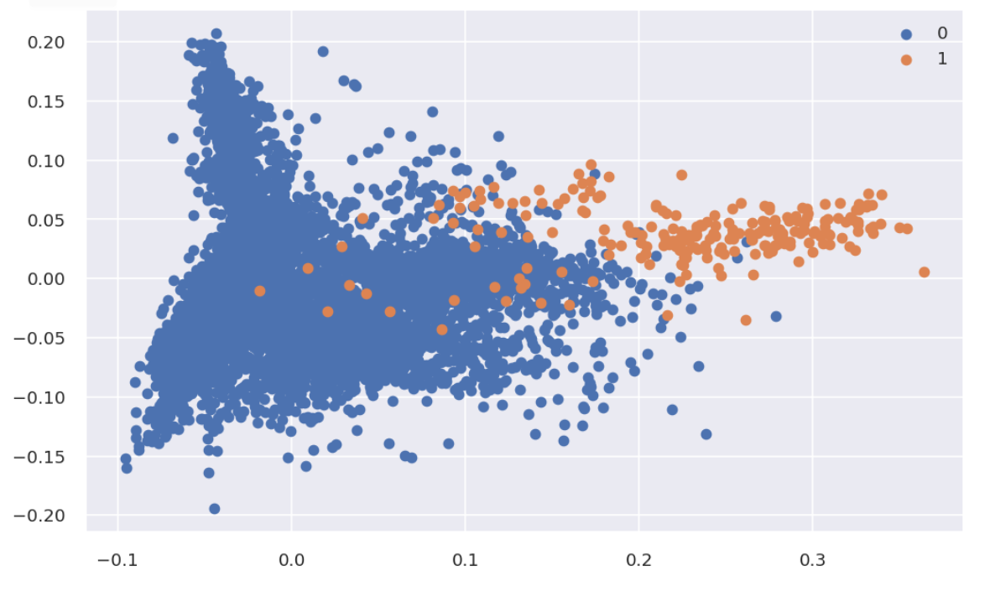
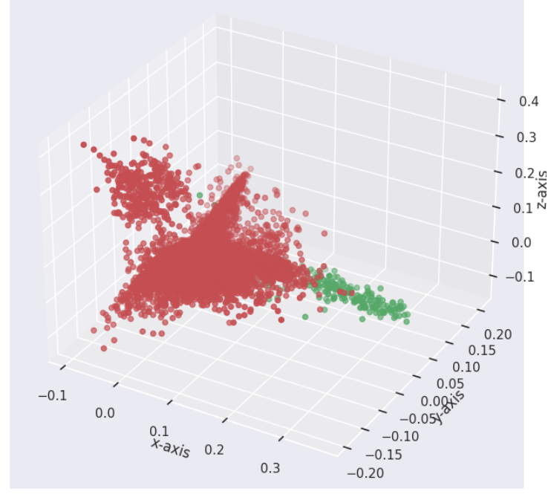
HIERARCHICAL (AGGLOMERATIVE) CLUSTERING GRAPHS
Graph in 2 - dimension
Graph in 3 - dimension

Slide 26
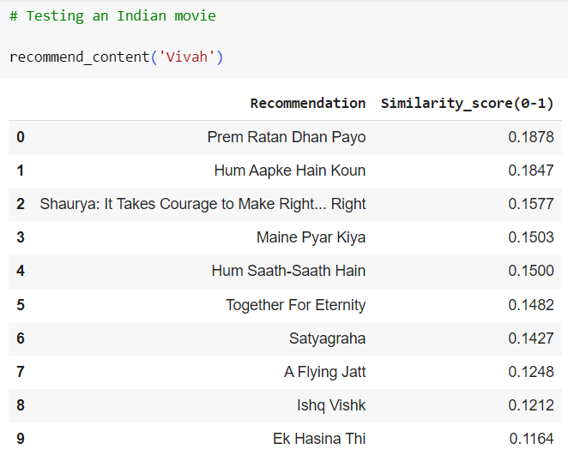
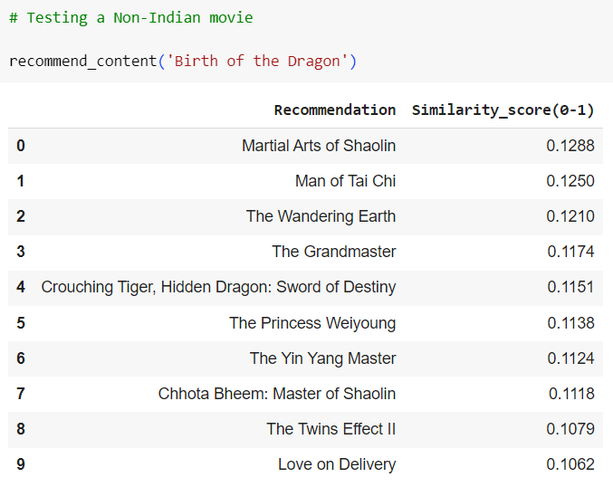
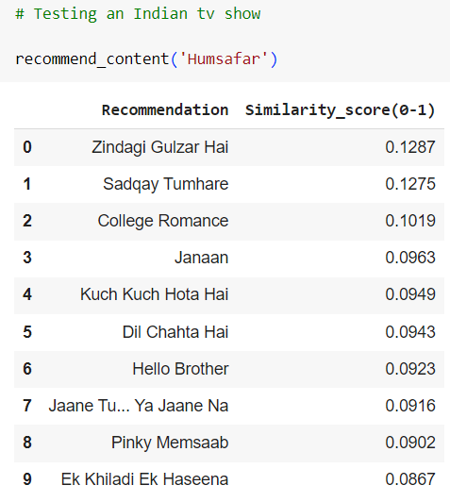
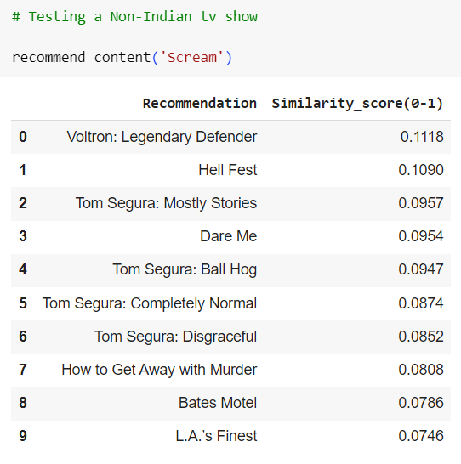
RECOMMENDATION SYSTEM
A recommendation system (or recommender system) is a class of machine learning that uses data to help predict, narrow down, and find what people are looking for among an exponentially growing number of options.

Slide 27
DEPLOYMENT
Model deployment in machine learning is the process of integrating your model into an existing production environment where it can take in an input and return an output.
The goal is to make the predictions from your trained machine learning model available to others.

Slide 28
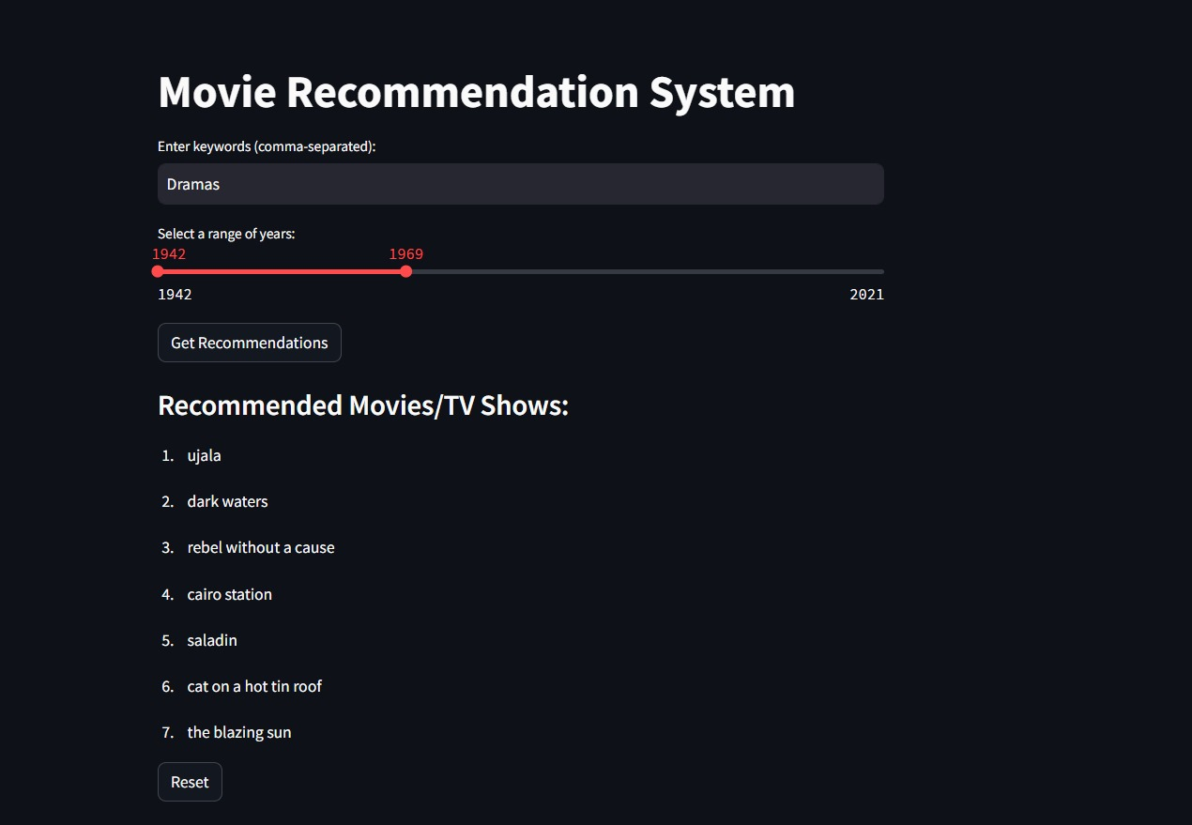

Slide 29
CONCLUSION
Based on the Exploratory Data Analysis (EDA)
Movies make up about two-thirds of Netflix content, with TV shows comprising the remaining one-third.
Adult and teen categories are prevalent on Netflix, while family-friendly content is more common in TV shows than in movies.
Indian actors dominate Netflix movies, while popular Indian actors are absent from TV shows.
Jan Suter is the most common movie director, and Ken Burns is the most common TV show director on Netflix.
The United States is the largest producer of movies and TV shows on Netflix, followed by India. Japan and South Korea have more TV shows than movies, indicating growth potential in that area.
International movies, drama, and comedy are the most popular genres on Netflix.
TV show additions on Netflix have increased since 2018, while movie additions have decreased. In 2020, fewer movies were added compared to 2019, but more TV shows were added..
Most movies on Netflix have durations between 80 to 120 minutes, while TV shows commonly have one or two seasons.
Based on ML clustering models
Implemented K-Means Clustering and Agglomerative Hierarchical Clustering, to cluster the Netflix Movies TV show dataset.
The optimal number of clusters we are getting from K-means is 4, whereas for Agglomerative Hierarchical Clustering the optimal number of clusters are found out to be 2.
We chose Silhouette Score as the evaluation metric over distortion score because it provides a more intuitive and interpretable result. Also Silhouette score is less sensitive to the shape of the clusters.
Built a Recommendation system that can help Netflix improve user experience and reduce subscriber churn by providing personalized recommendations to users based on their similarity scores.

Slide 30
THANK YOU

